Slide 1
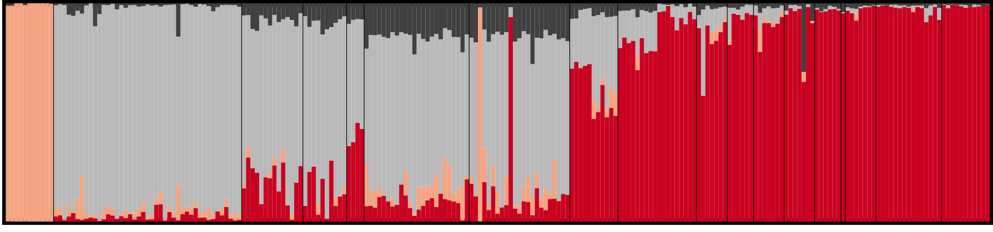
Lab 10: Inference of population structure
BIOL4174/5174 Conservation Genetics Spring 2018

Slide 2
Struc outline
Have data X, need to infer populations of origin Z, and allele frequencies of those pops Y
Assume ancestral populations are in HWE, and all individuals are produced from admixture (or not) between these ancestral pops
Assign individuals to K clusters by finding clusters which minimize departure from HWE, and minimize LD

Slide 3
Population structure
Populations generally don’t consist of a single randomly-mating unit
Assortative mating due to:
Dispersal limitation
Geographic barriers
Differential adaptation
etc
Byrne et al (2018) PLoS Genetics

Slide 4
Inferring population structure
Most common approaches:
Approaches we’ve seen (genetic distances, F-statistics, AMOVA, etc)
Phylogenetic approaches (may not be informative at sub-specific scale)
Principle Components Analysis (PCA) / Dimension reduction approaches
Assignment Tests

Slide 5
Inferring population structure: PCA
Genetic data is very large
Sometimes hundreds or thousands of loci
Individuals are described by multi-dimensional vector of marker configurations
Low-dimensional projection can help see patterns
PCA: One of many methods which can be used to highlight patterns in highly dimensional datasets
Find major axes of variation in multidimensional datasets
Allows to transform data and visualize pattern

Slide 6
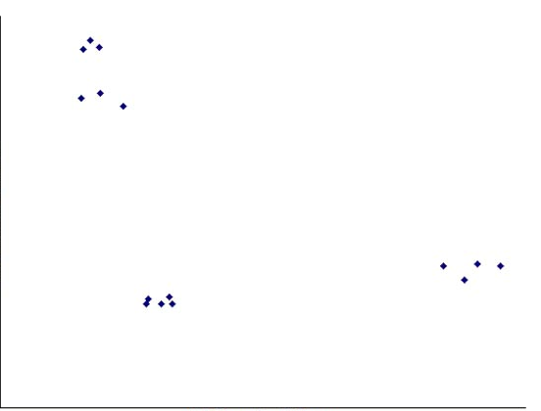
Two-Dimensional Example

Slide 7
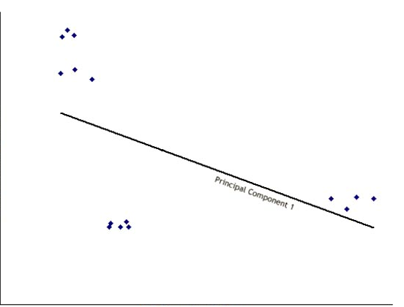
Two-Dimensional Example

Slide 8
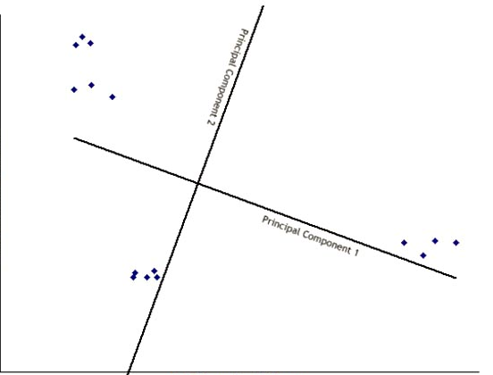
Two-Dimensional Example

Slide 9
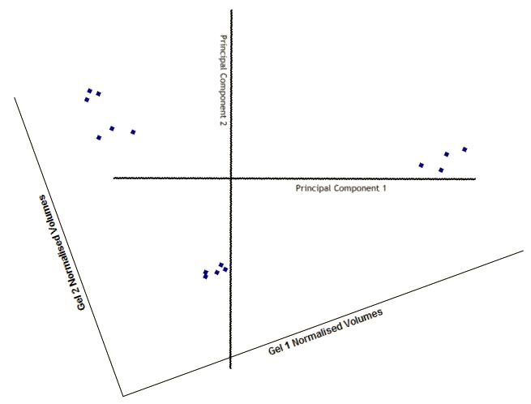
Two-Dimensional Example

Slide 10
Inferring population structure: PCA
Most commonly applied of this type of analysis
Find new dimensions (Principal Components) which:
Are linear combinations of the original ones
Are uncorrelated with one another
Capture as much variance in the original data as possible

Slide 11
Inferring population structure: PCA
Steps
Calculate covariance matrix (=joint variability)
Find vectors (axis) explaining covariance from this matrix
These are called eigenvectors
Each has an associated eigenvalue describing how much variance it explains
Eigenvectors are orthogonal, or perpendicular to one another
Sort eigenvectors by percentage variation explained
First few axes usually explain majority of variation
Eigenvector explaining the most variation is Principal Component 1 (and same for PC2, etc…)
Often components of very little significant are ignored

Slide 12
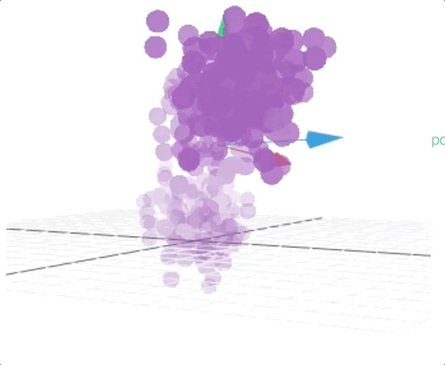
Inferring population structure: PCA

Slide 13
Inferring population structure: PCA

